Slide 1
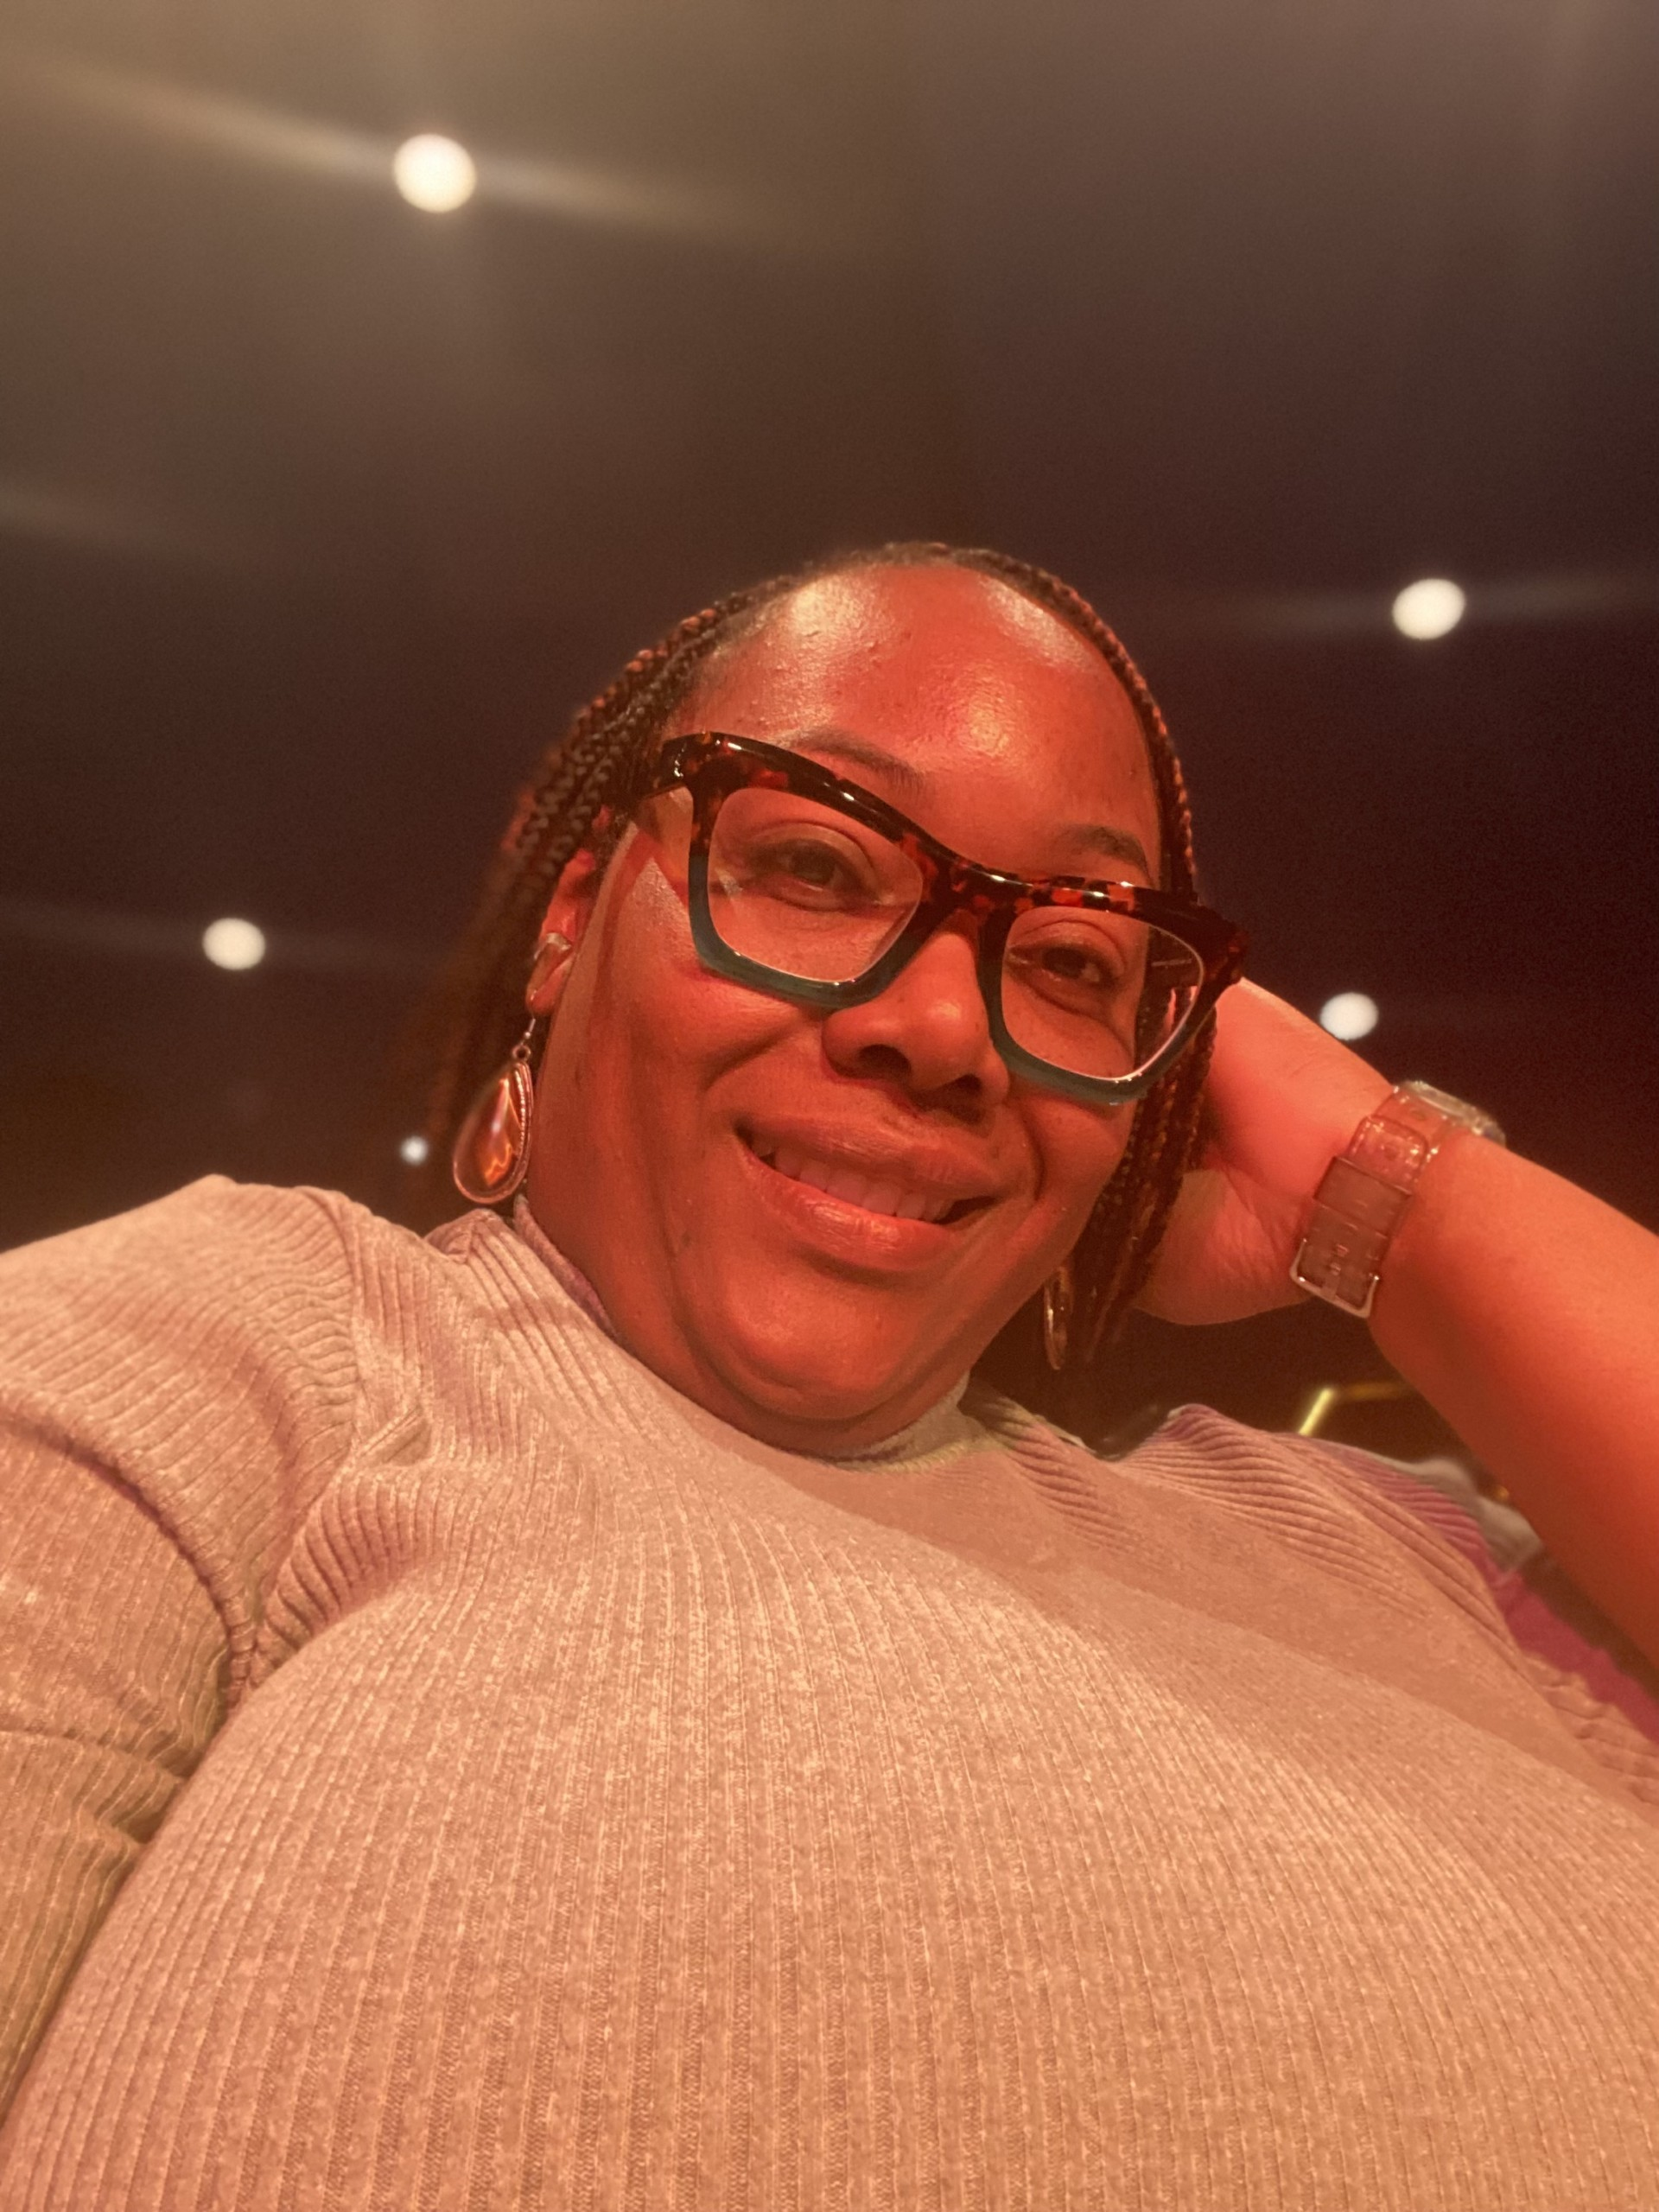
Ms. Harvey 8th Grade Math

Slide 2
My Contact Information
Email: HarveJa1@boe.Richmond.k12.ga.us
Class Dojo: www.classdojo.com/ul/p/addKid?target=class&class=CR7T358
Google Voice: 762-233-1211
School Number: 706-592-3730

Slide 3
Daily Schedule
Students may start entering the building at 8:45 am. Dismissal begins at 4:05 pm.
9:15 am – 10:05 am Acceleration
10:05 am – 11:35 am Connections
11:35 am – 12:35 pm 1st Period
12:35 pm – 2:05 pm 2nd Period
Lunch is included in 2nd Period from 12:55 pm – 1:25 pm.
2:05 pm – 3:05 pm 3rd Period
3:05 pm – 4:05 pm 4th Period
Designated restroom breaks will be scheduled throughout the day at 11:55 am, 1:40 pm, 3:15 pm.

Slide 4
CHECKOUT MY WEBSITE TO VIEW THE FOLLOWING INFORMATION
Class Calendar
Class Syllabus/Supply List
Resources
Additional Information

Slide 5
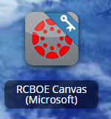
RCSS Learning Platform and Canvas
New to the Richmond County
Go to rcboe.org
Click Student
Click Launch Pad
Watch logging into Canvas as a student.
https://rcboe.instructuremedia.com/embed/048204ea-777e-4c04-9fc0-357111372c96
Your child will login through Launch Pad to access RCBOE Canvas.
Click link to watch Tutorial Video
https://www.rcboe.org/Domain/16265

